Slide 1

C - Care for and Support Individuals and Families
What Every CHURCH Can Do
KayWarren.com/MentalHealth

Slide 2
C - Care for and Support Individuals and Families
What Every CHURCH Can Do
“You must be compassionate, just as your Father is compassionate.” - Luke 6:36 (NLT)
KayWarren.com/MentalHealth

Slide 3
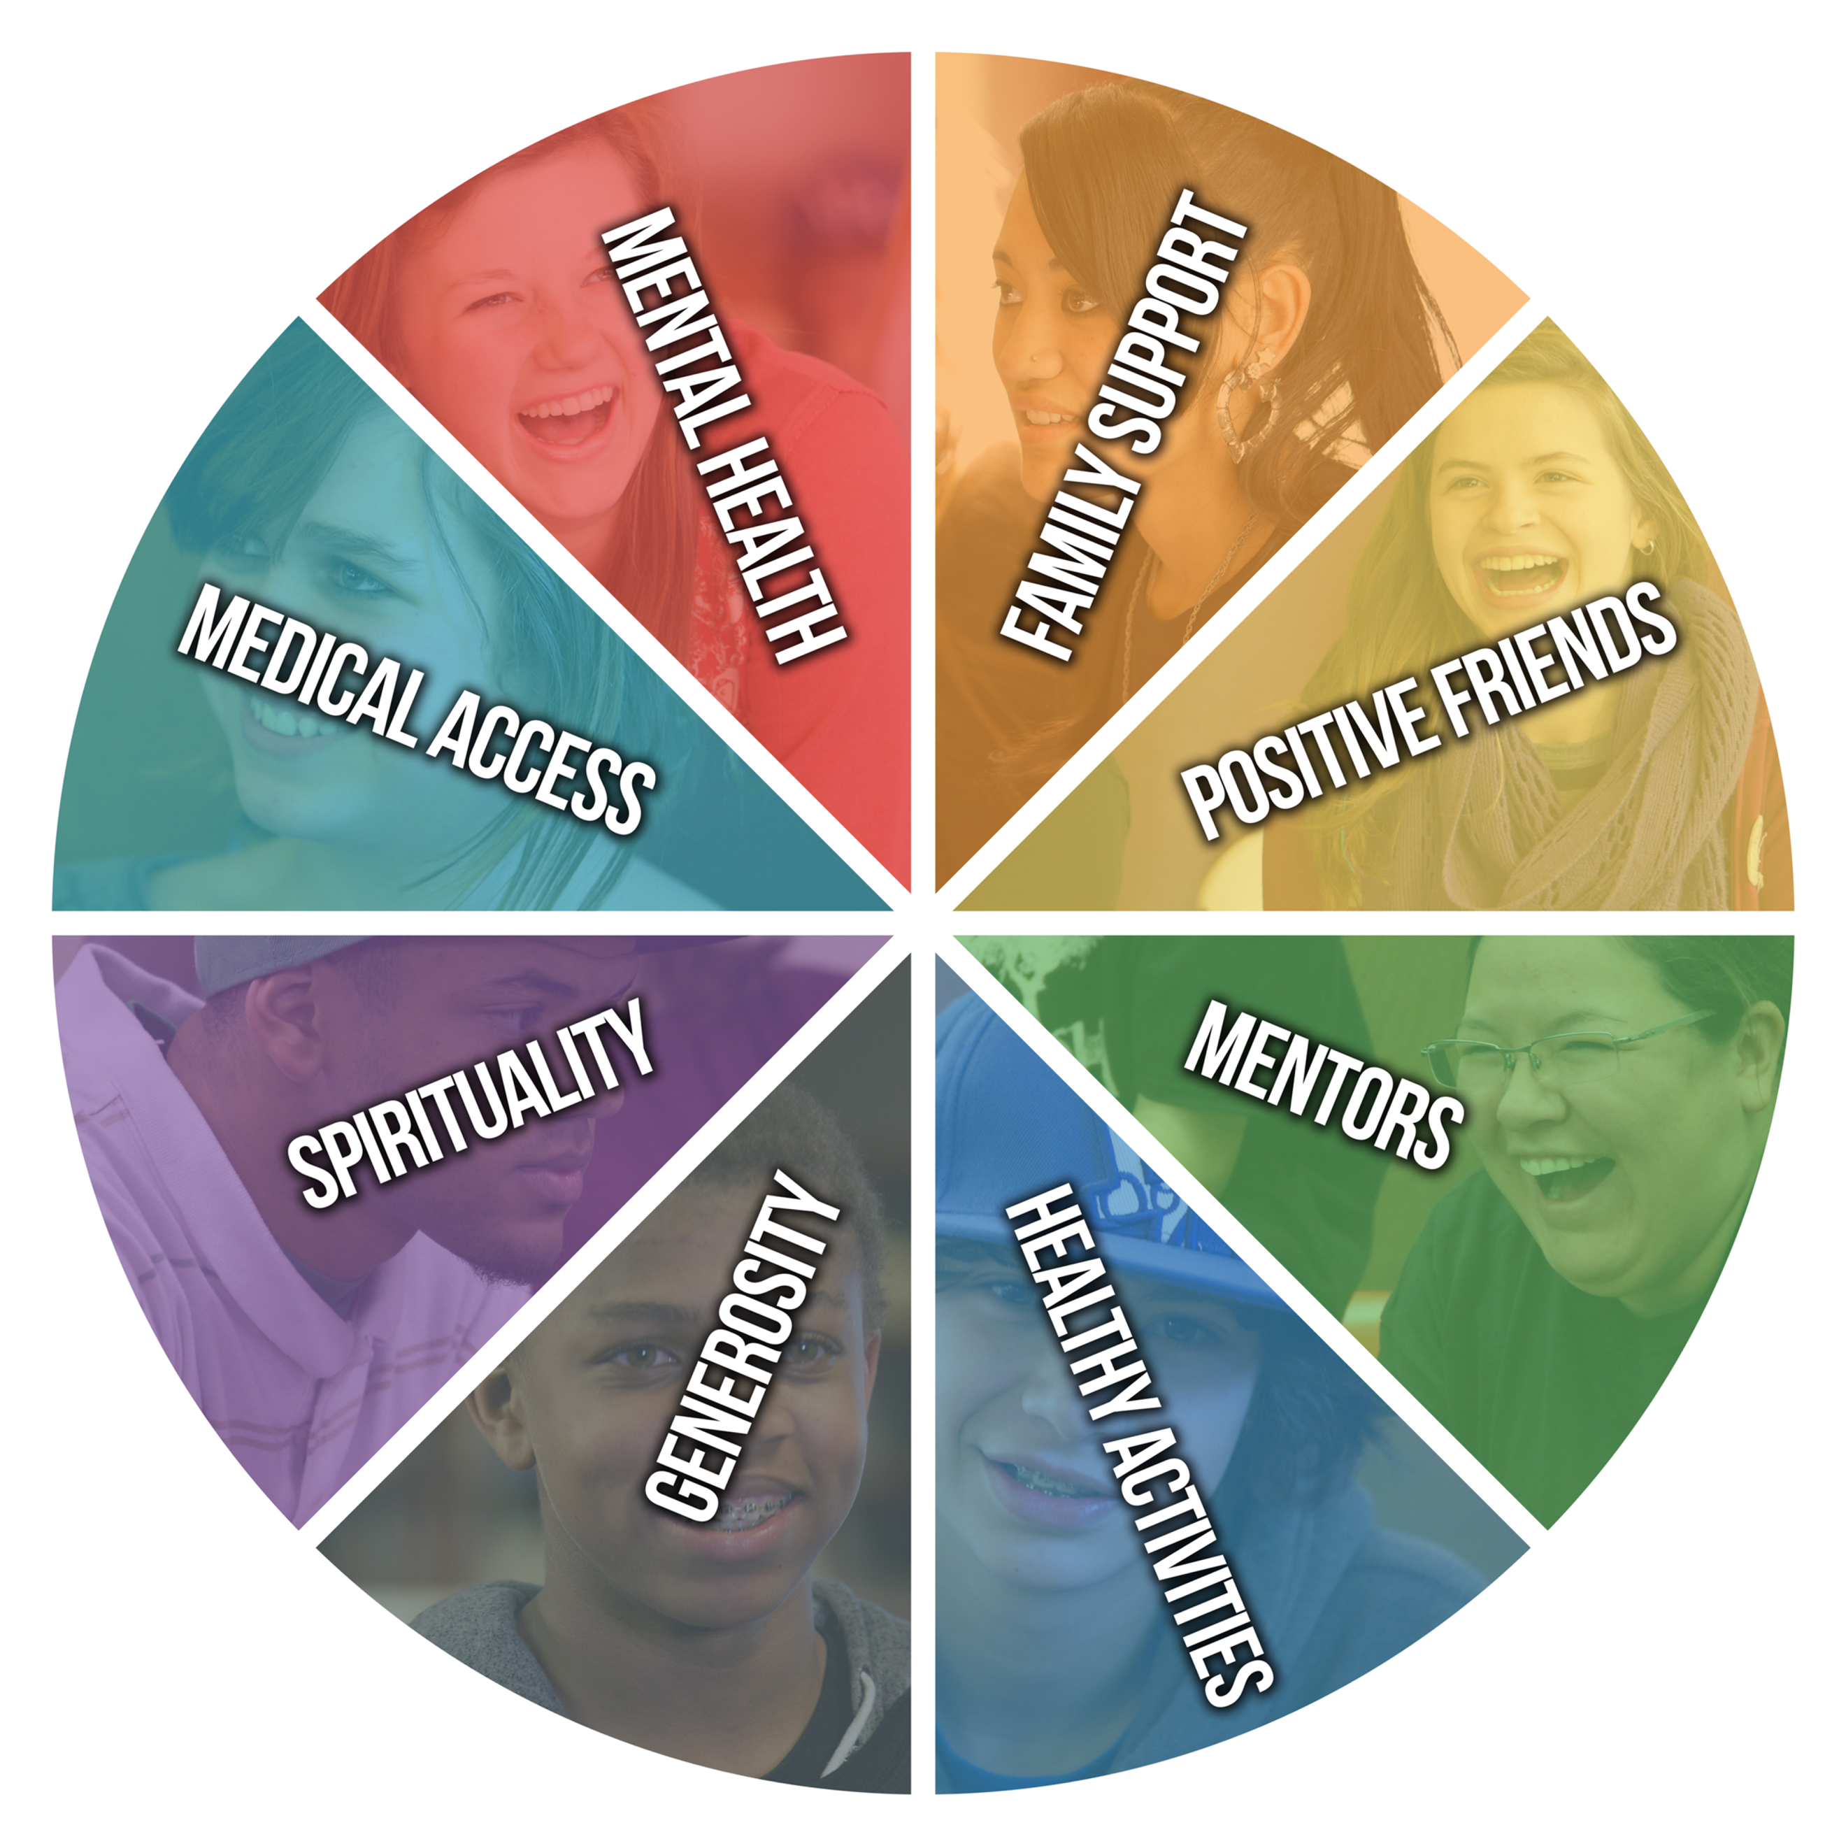
Sources of Strength
KayWarren.com/MentalHealth

Slide 4

Spiritual Support for Individuals
KayWarren.com/MentalHealth

Slide 5

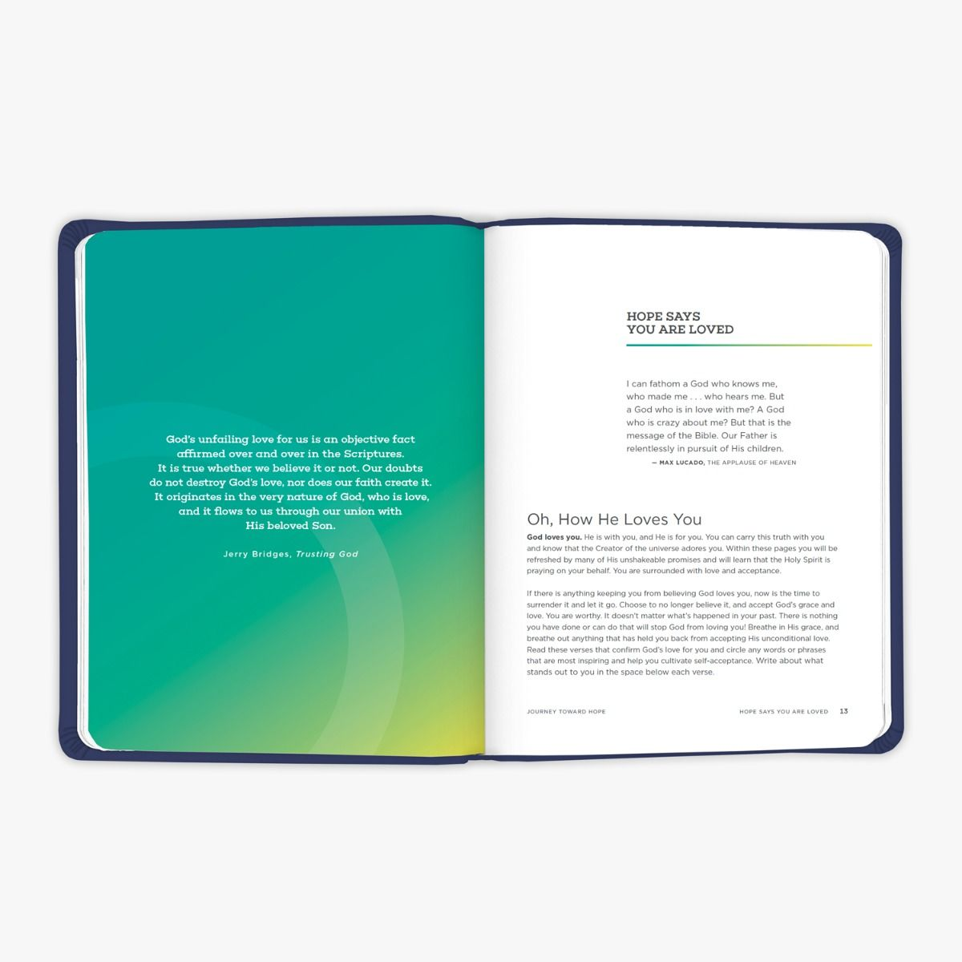

Journey Toward Hope
KayWarren.com/MentalHealth

Slide 6
C - Care for and Support Individuals and Families
H - Help with Practical Needs
What Every CHURCH Can Do
KayWarren.com/MentalHealth

Slide 7
C - Care for and Support Individuals and Families
H - Help with Practical Needs
What Every CHURCH Can Do
“If we see others in need, yet close our hearts against them, how can we claim that we love God?” - 1 John 3:17 (TEV)
KayWarren.com/MentalHealth

Slide 8
C - Care for and Support Individuals and Families
H - Help with Practical Needs
U – Unleash Trained Volunteers
What Every CHURCH Can Do
KayWarren.com/MentalHealth

Slide 9
C - Care for and Support Individuals and Families
H - Help with Practical Needs
U - Unleash Trained Volunteers
What Every CHURCH Can Do
“God has given gifts to each of you from his great variety of spiritual gifts. Manage them well so that God’s generosity can flow through you.” – 1 Peter 4:10 (NLT)
KayWarren.com/MentalHealth

Slide 10
C - Care for and Support Individuals and Families
H - Help with Practical Needs
U - Unleash Trained Volunteers
R - Remove the Stigma
What Every CHURCH Can Do
KayWarren.com/MentalHealth

Slide 11
C - Care for and Support Individuals and Families
H - Help with Practical Needs
U - Unleash Trained Volunteers
R - Remove the Stigma
What Every CHURCH Can Do
“You have not strengthened the weak or healed the sick or bound up the injured.” – Ezekiel 34:4 (NIV)
KayWarren.com/MentalHealth

Slide 12
C - Care for and Support Individuals and Families
H - Help with Practical Needs
U - Unleash Trained Volunteers
R - Remove the Stigma
C - Collaborate with the Community
What Every CHURCH Can Do
KayWarren.com/MentalHealth

Slide 13
C - Care for and Support Individuals and Families
H - Help with Practical Needs
U - Unleash Trained Volunteers
R - Remove the Stigma
C - Collaborate with the Community
H - Offer Hope
What Every CHURCH Can Do
KayWarren.com/MentalHealth

Slide 14
H - Offer Hope
What Every CHURCH Can Do
“I will…transform the Valley of Trouble into a gateway of hope.” – Hosea 2:15 (NLT)
KayWarren.com/MentalHealth

Slide 15
C - Care for and Support Individuals and Families
H - Help with Practical Needs
U - Unleash Trained Volunteers
R - Remove the Stigma
C - Collaborate with the Community
H - Offer Hope
What Every CHURCH Can Do
KayWarren.com/MentalHealth

