Slide 1
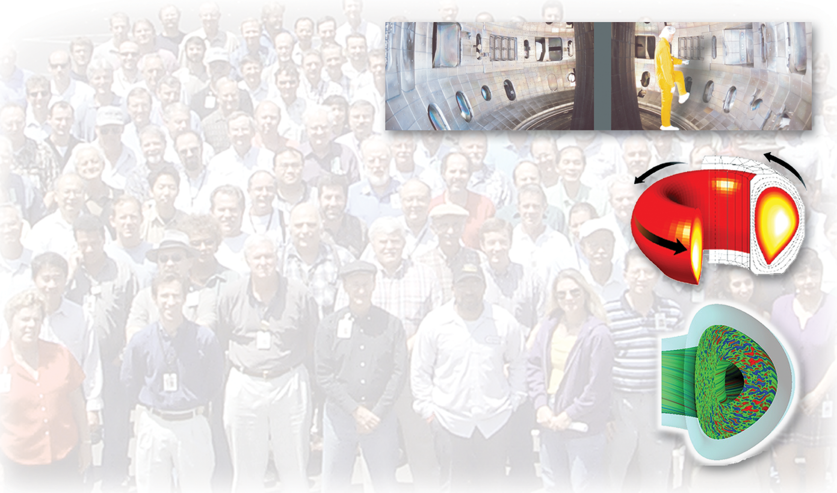


Plasma & Fusion on Earth: merging age-old natural phenomena into your present and future
Presented by
Rick Lee
Chief Operator, DIII-D Operations
Manager, Energy/Fusion Outreach Program
General Atomics
San Diego, CA
“Tell me and I forget. Teach me and I remember. Involve me and I learn.” – Benjamin Franklin
2. “We are all born ignorant, but one must work hard to remain stupid.” – Benjamin Franklin
rick.lee@gat.com

Slide 2
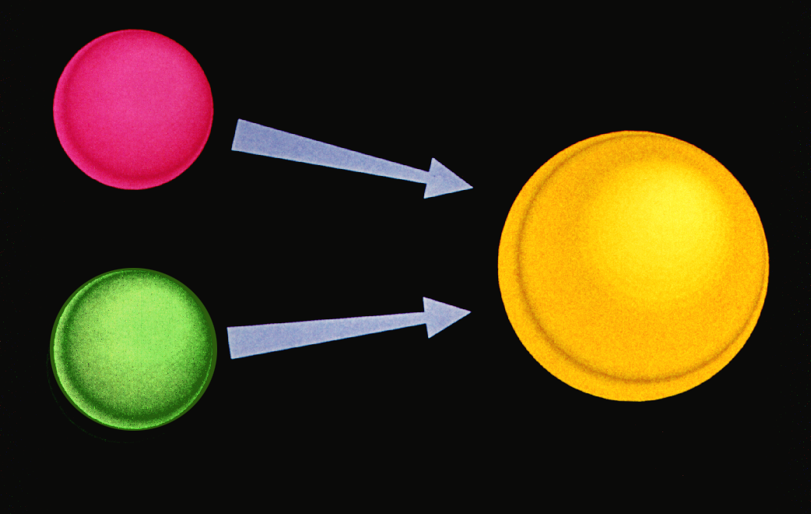
Nuclear fusion – We Would Not be Here Without it!
Basic idea…..
nucleus
+
ENERGY
nucleus
Larger nucleus
Outcome = different nucleus plus energy
19
Notes:
Basic nuclear fusion involves bringing together light element nuclei (for example, Hydrogen ions, H+, with no electrons) together to form a larger nucleus with a release of energy. Sounds simple, but the required conditions are quite extreme in order to satisfy the reaction: high temperature, high density, and high energy confinement times (low energy loss). Inside stars, the temperature may range from 10M K (sun’s Tcore is about 13 M K) to hundreds of millions to a billion K in a massive star (where elements up to iron are produced). The sun/star density is much higher than we can achieve in the laboratory, so we make up for modest density conditions with relatively high temperature conditions (T ≈150 M K).
In social situations, fusion is a term meaning bringing together as well – fusion food (Asian-American), fusion music, Ford Fusion automobile, etc.

Slide 3
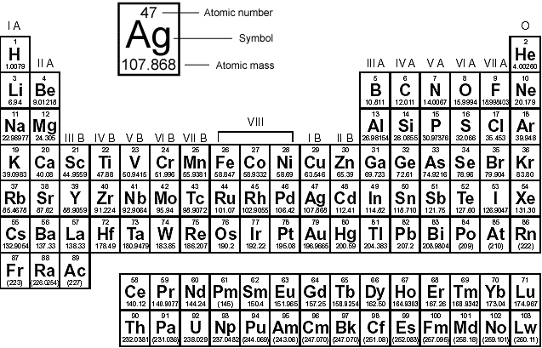
In Massive Stars: Fusion Begins Building the Periodic Table of the Elements: a Self-portrait of You and Me!
Mostly of BB origin
Mostly of H/He fusion origin
Mostly of SN origin
Nuclei relatively stable
NOTE: this is a simplification of many natural nucleosynthesis processes, some not shown
Notes:
Generalized comments on element formation – H, He, and Li from (shortly after initiation of) big bang; elements in pink primarily from nucleosynthesis inside massive stars (10x – 100x larger than sun; short lifetime of about 10M yrs). Iron nuclei are very stable and will not fuse further in massive star (like ash in a fire place – conditions aren’t right to continue burning the ash). With formation of iron, fusion process slows, gravity wins and collapses star catastrophically (a few seconds!) with a resulting supernova event. Elements in blue primarily from supernova – made within about 3 minutes of explosion through fast and slow neutron capture processes. These neutron capture processes require energy, thus they are endothermic unlike the exothermic fusion process. Important to note: the stable isotopes are really quite stable…. There is likely H from the big bang in our bodies; likewise, it is likely that nearly 100% of the atoms in our body are at least about 5-6 BY old – leftovers from a supernova in “our” vicinity 5-6 BY ago.

Slide 4
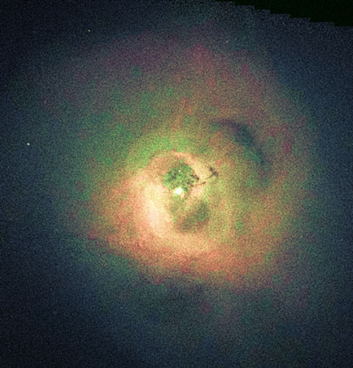
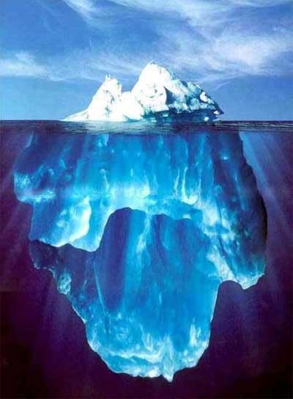
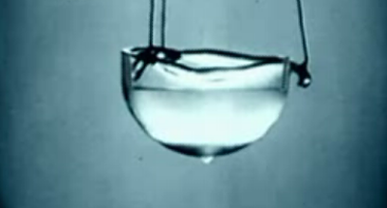
Matter exists in a wide temperature range: a few examples
Celsius
100,000,000 D, T nuclei fuse in tokamak
16,000,000 center of sun (H fusion)
100,000 lightning (no fusion, but ionized O, N)
10,000 fluorescent light (Argon & mercury ions)
6,000 surface of sun (what we see)
3,400 W (tungsten) melts
1,500 Fe (iron) melts
100 water boils at 1 atm
23 room temp
0 water ice
Dry Ice (CO₂) -78
LN₂ -196
LHe -269
Abs. Zero -273

Slide 5
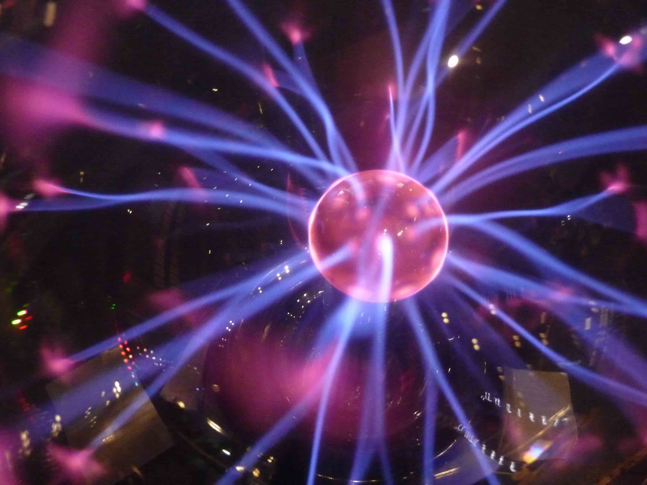
Plasma is Called the 4th State of Matter and it is the 1st Step to Fusion
A plasma is an ionized gas (1 or more e- removed from, or added to, a neutral atom).
Plasma is called the “4th state of matter.” Why?
About 99% of the visible mass of the universe is in a plasma state of matter.
  However, this is relatively little of the overall matter of the universe – about 96% of the universe is dark energy + dark matter!
‘Plasma’ was coined by Tonks and Langmuir in (1929)
Notes:
4

Slide 6

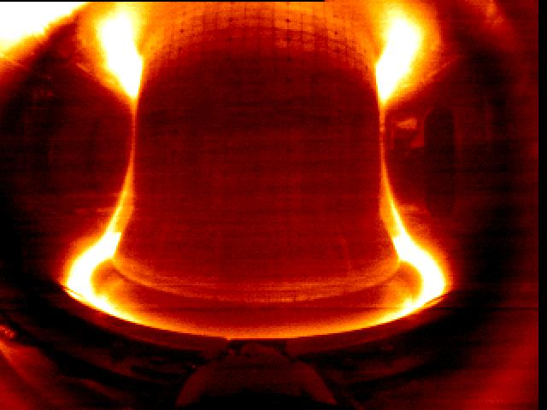
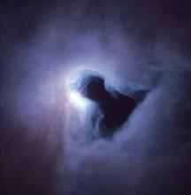
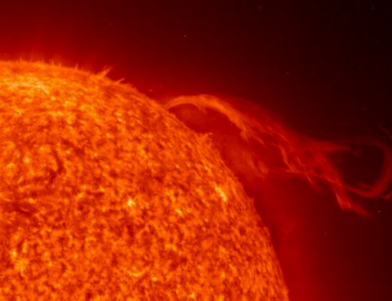
Where can plasma be found?
Examples of plasmas on Earth:
  Lightning
  Neon and Fluorescent Lights
  Laboratory Experiments
Examples of astrophysical plasmas:
  The sun and the solar wind
  Stars, interstellar medium

Slide 7
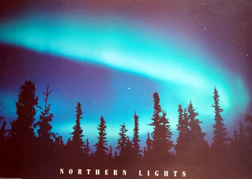
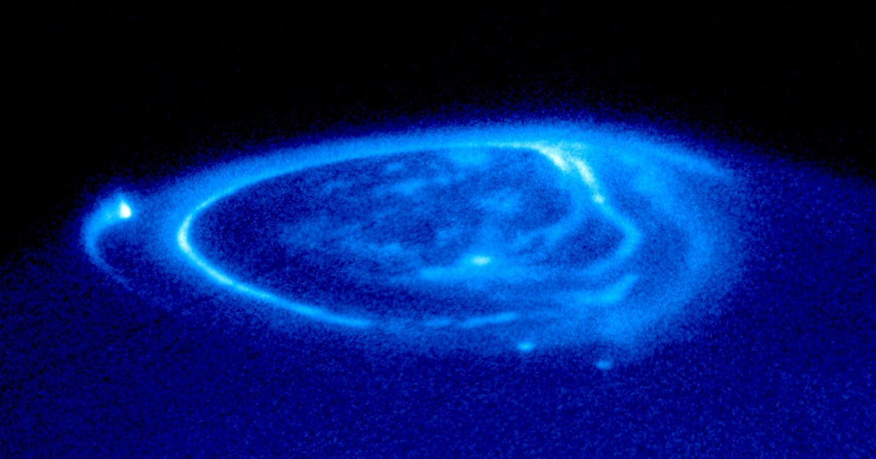
Auroras are particularly impressive displays of plasma seen on (and from) Earth
Auroras are formed from the light emitted by excited and ionized molecules of a planet’s atmosphere. The excitation and ionization occur from collisions with charged particles trapped in a planet’s magnetic fields. The charged particles emanate from the universe - primarily the sun, in the case of Earth’s auroras (left image), and from the sun and the volcanic moon, Io, in Jupiter’s case (right image).

Slide 8
Why are we interested in plasmas?
Fusion Energy
  Potential source of relatively safe & clean, sustainable & abundant energy.
Astrophysics
  Understanding plasmas helps us to understand stars and stellar evolution. Interaction of solar wind particles and Earth’s magnetic field.
Upper atmospheric dynamics
  The ionosphere is a plasma.
Plasma Applications
  Plasmas can be used to build computer chips, to clean up toxic waste, and drive space craft.
Notes:
3/6/96
8
ORNL
Properties of plasmas
http://demo-www.gat.com/

Slide 9
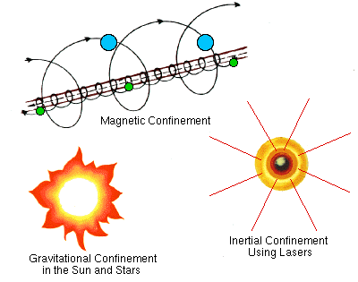
Methods for confinement – or, how do you hold on to something that is > 5,000 K?
Hot plasmas are confined with gravitational fields in stars.
In fusion energy experiments magnetic fields are used to confine hot plasma, and inertial confinement uses an imploding surface.
Notes:
When you heat a gas it will expand. This is also true for plasma.
The sun is extremely massive and the gravitational forces are large enough to confine the expansion energy from nuclear fusion heating.
On Earth, two methods have been tried to confine hot plasmas:
1) Charged particles are confined with magnetic fields in magnetic fusion energy experiments.
2) In inertial confinement, a small, dense plasma is created by bombarding a pellet with lasers.

Slide 10
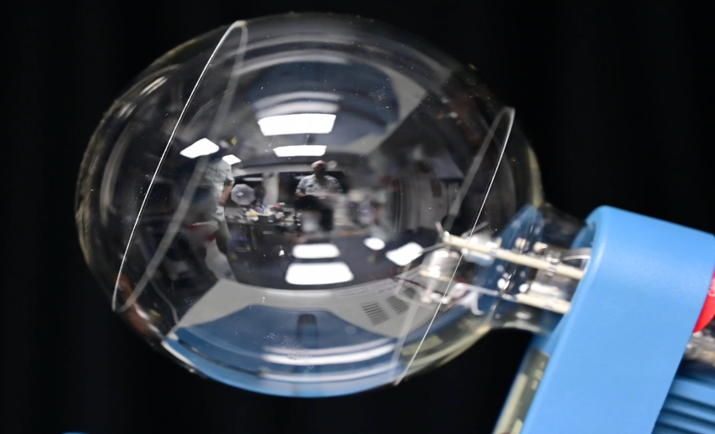
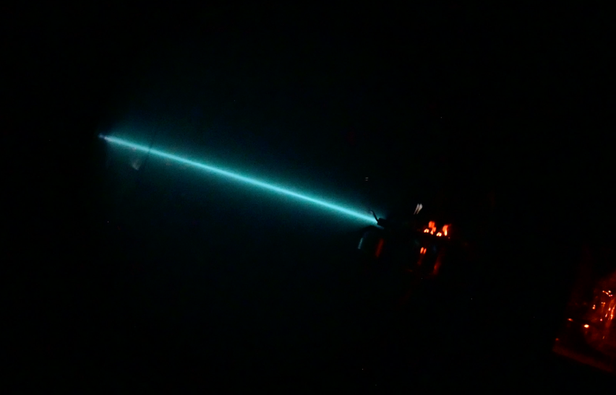
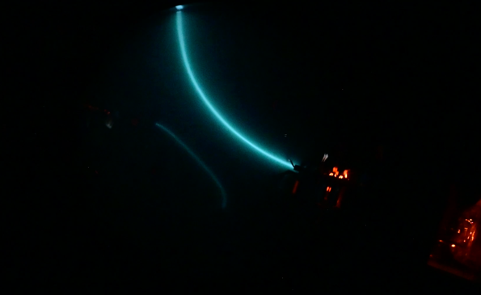
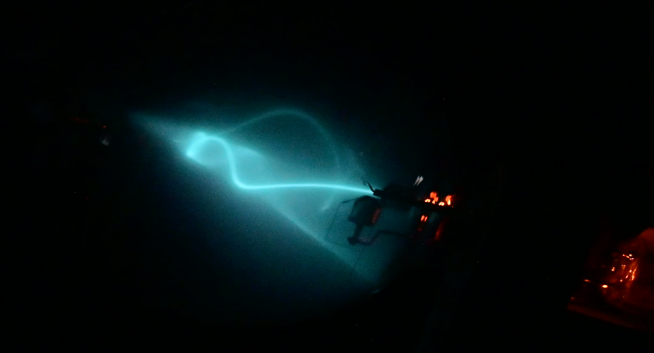
Electric and Magnetic Fields Influence the Motion of charged Particles
Electron beam apparatus
  evacuated bulb with some He gas
  e- beam
  may use electromagnets or permanent magnet
  electric field, E, between small plates
E field force: F_{E} = qE (q is charge)
  Causes straight-line motion
Magnetic fields have an effect on moving & charged particles
  F_{B} = q(v x B) causes circular motion
F_{E,B} = q(E + v x B).
  What type of motion results?
  (Line + circle = spiral ! )

Slide 11
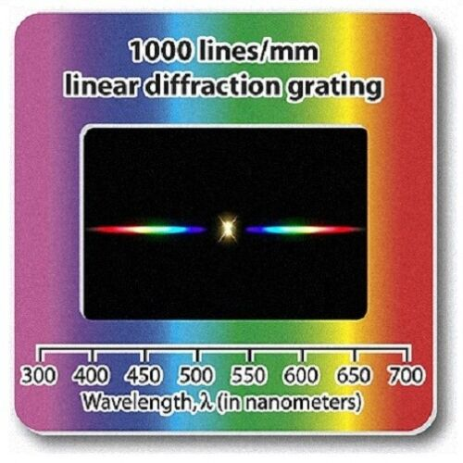
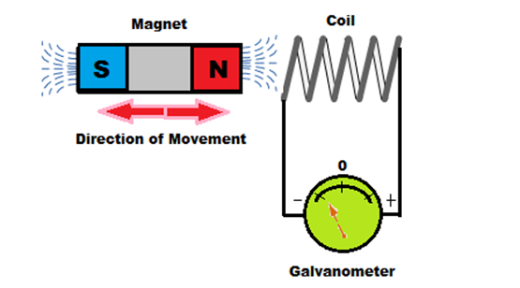
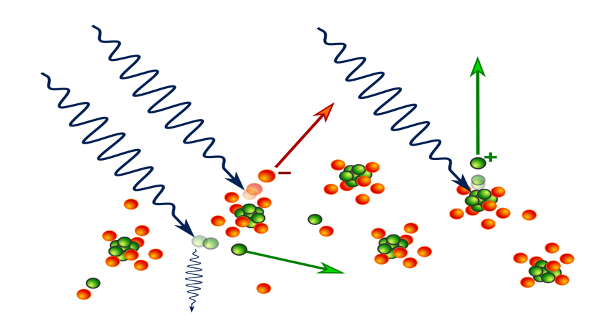
We Measure Plasma Characteristics Based on Various Phenomena
Emitted light
  spectroscopy based on wavelength interference can measure temperature, ionization state, impurity content
Presence of charge
  Pickup coils measure plasma magnetic field
  Voltage-biased probes (Langmuir) measure e- temperature & density
  Thomson scattering of light from plasma electrons (temp & density)
  Plus many other diagnostics
Circuit basics
wikipedia

Slide 12
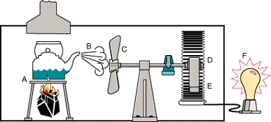

The ultimate goal of fusion research is…
To use energy from the process of fusion to find pathways to:
1. heat water
2. make steam
3. turn a turbine (propeller set)
4. turn an electrical generator
5. make electricity
Fusion Process
Notes:
We know how to generate electrical energy through magnetic coil-based technology and present day generators are run using gravity (falling water), chemical heat (gas and oil burning), nuclear (fission) as an ‘original’ energy source. In fusion-based power plants, the energy released through fusion processes will be used as the ‘original’ source of energy.

Slide 13
Why do we need new sources of energy?
The cost of mining coal and oil will eventually be prohibitive (reduced supply; there are better uses for these resources than burning)
Water, wind, solar does not satisfy needs in all locations
Fission may be supply-limited, and has weapons concerns
Demand for electrical energy increases as population increases (electrical energy for water pumps, refrigeration, other large-scale industrial uses.)
What is ‘electrical’ energy? A method to transfer energy from one form to another (eg., falling water → electrical generator → heating toast)
Why is electrical energy prevalent? We understand how to safely transfer, contain, utilize better than other methods

Slide 14
Protons and Neutrons And their Binding Energies are the Players in Basic Nuclear Fusion Reactions
+
The Iconic Ionic Players
proton
neutron
The hydrogen isotopes
+
Hydrogen ion = proton = p⁺
D⁺ + D⁺ → T⁺ + p⁺ + 4.03 MeV
+
Deuterium ion = D⁺
OR (50:50)
+
D⁺ + D⁺ → ³He⁺⁺ + n + 3.27 MeV
Tritium ion = T⁺
D⁺ + T⁺ → ⁴He⁺⁺ + n + 17.6 MeV
The helium isotopes
++
D⁺ + ³He⁺⁺ → ⁴He⁺⁺ + p⁺ + 18.3 MeV
³Helium ion = ³He⁺⁺
++
⁴Helium ion = ⁴He⁺⁺

Slide 15
Mass ‘goes’ into Energy in Fusion Reactions: D-T Reaction As A Power Plant Example
D⁺
n
14.1 MeV
He⁺⁺
3.5 MeV
T⁺
The above reaction will be typical of fusion power plants. Fusion reactions in nature use H and many other low-mass atoms found in the periodic table.
Although we say the process “turns mass into energy,” a more understandable way to put it is: the origin of the released energy is the rearrangement of nuclear bonds.
Much energy is needed to overcome the repelling forces of the reactant ions. High temperature (≈ 10 -100⁺ million K) conditions are required.
High energy neutron will be used in a multi-step process to heat fluid (water) to gas to turn turbine, while energy from alpha particle (He²⁺) is used to sustain reaction

Slide 16
Advantages of Fusion as an Energy Producer
Fusing deuterium and tritium to produce significant energy is achievable
No CO₂ (or other greenhouse gas) output
Fuel resource will last many (millions?) years
  Deuterium, a hydrogen isotope, is found in all water
  Tritium is a byproduct of the process and is harvested for reuse
No radioactive wastes - although there will be local activation of structural materials. Reactor materials may be activated for 100s of years. This is less time than the 4.5 BY half-life of fission materials.
Can be used day or night, with or without the presence of wind or waves

Slide 17
Disadvantages of Nuclear Fusion
Limited helium supply on Earth - He is used to cool magnets (superconducting) and as a cryo-pumping resource – while helium is not a fuel, it may be a limiting resource?
Fusion is a difficult science; some have said it is the most ambitious and difficult undertaking ever attempted by humankind.
Technology is advanced (read: NOT cheap)

Slide 18
The Magnetic Confinement Fusion Reactor
How can we fuse these light atoms?
  Make a plasma---ionize the gas atoms
  Hold on to the plasma---use a magnetic field
  Heat the plasma---use particle beams and electromagnetic energy (RF, microwave)
  Harness the energy---use a series of heat exchangers involving liquid metals and other fluids
  Provide electricity as the energy conveyance method to industries and households.

Slide 19
Controlling fusion with magnetic fields
An environment is required that allows for very high temperature plasma to exist while fusion reactions take place.
Large chambers capable of isolating desired fuel atoms (D, T) from undesirable atoms (N, O, etc.) are used. These are called vacuum chambers.
A primary method for controlling the fusion reactants (positive ions) include magnetic fields.
Most magnetic confinement devices in use today have a toroidal shape.
Large magnetic fields are created by driving currents through coils wrapped around the torus.
Note: Fusion research has a long history of trying various geometries, including linear and toroidal shapes.
Notes:
There are a number of different types of toroidal (shaped like a doughnut) confinement devices which differ in how the magnetic fields are created. The one most widely researched is the tokamak.

Slide 20
Building a Tokamak
Plasma Heating:
Neutral Particle Beams
Microwaves
Radio waves
POLOIDAL
Magnetic
field
Shaping &
Control coils
(PF / F coils)
Toroidal
Magnetic field coil
I_{p}
Transformer
(ohmic coil)
B_{t}
Gas puff
Solid pellets
Vacuum chamber
Plasma Fuelling

Slide 21
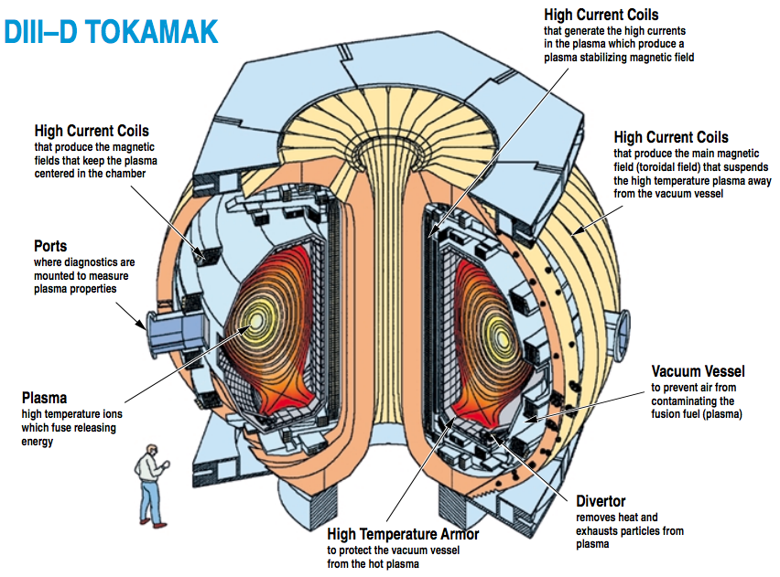

Slide 22
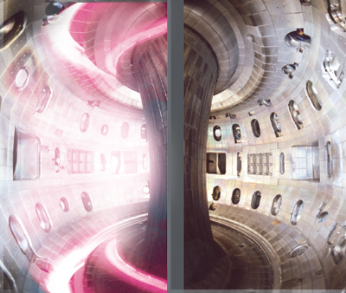
DIII-D, a mid-size tokamak, is operated by General Atomics for the US Department of Energy and is located in San Diego, CA. It is the largest device of its kind in the US.
plasma
No plasma

Slide 23
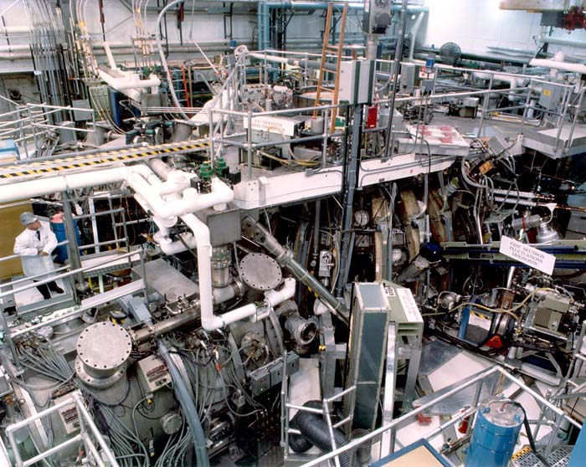
Outside DIII-D… an industrial-scale experiment

Slide 24
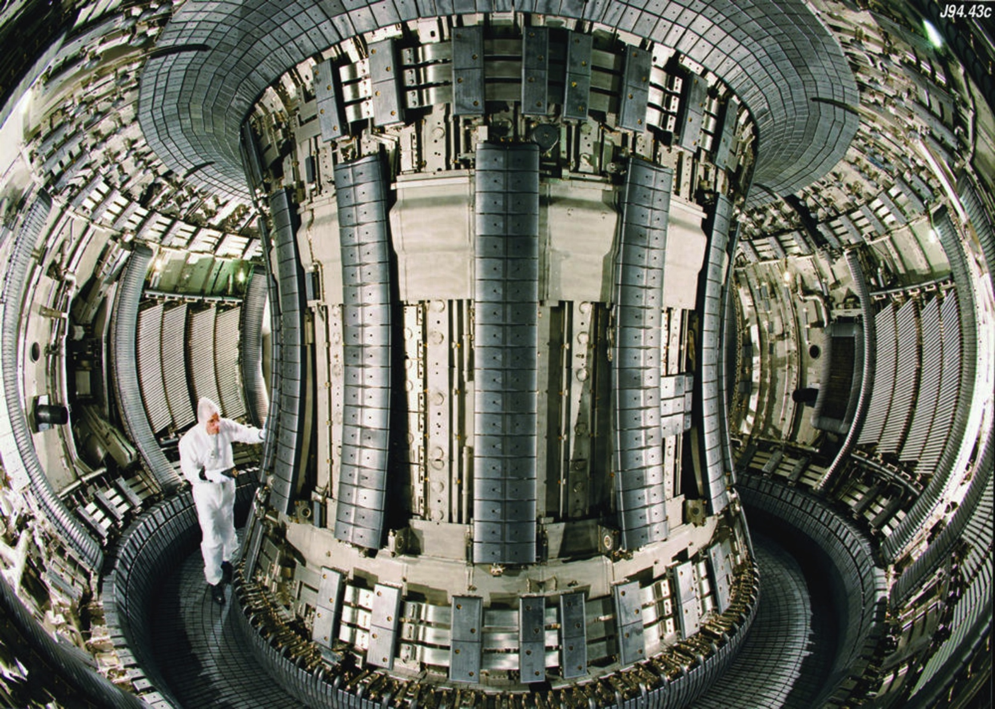
Inside the largest tokamak: Joint European Torus - JET

Slide 25
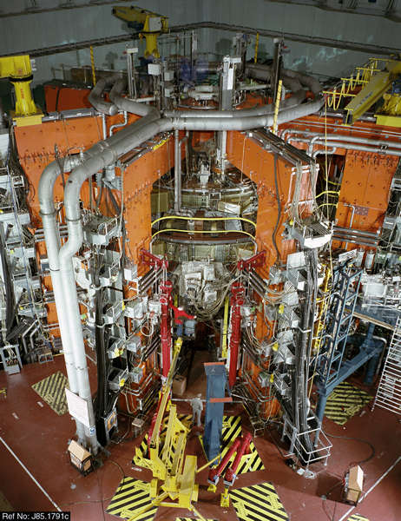
Joint European Torus: outside
Person
Notes:
The JET tokamak (the device type, tokamak, indicates a particular magnetic field geometry) is located in England.
It has a major radius, R, of 2.98 meters and a minor radius, a, of 2.45 meters. Itt is a D-shaped donut and the height, h, is over 4 meters.
A cross section of the vessel.

Slide 26
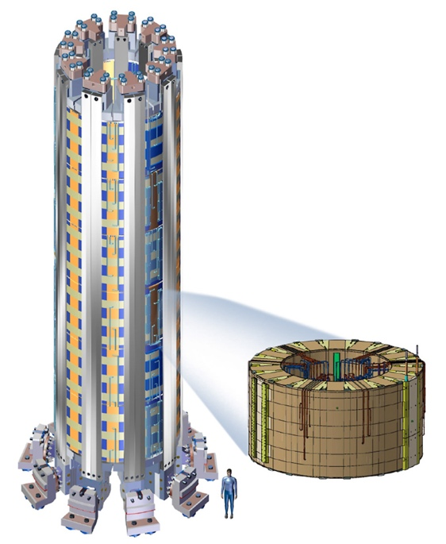
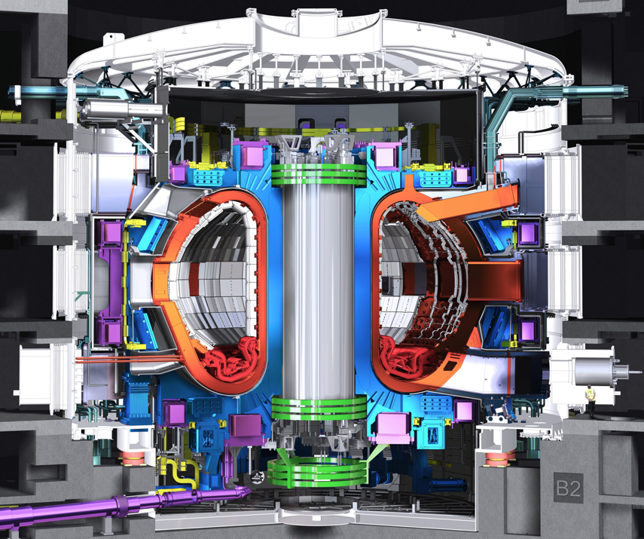
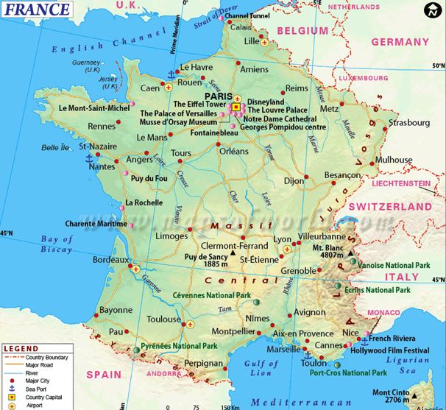
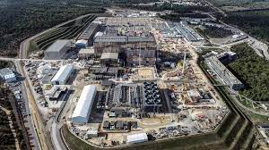
The next step: ITER - “The Way” is being built now in Southern France (see ITER.org)
- International
- Large scale tokamak design
- Produce fusion energy (500 MW)
- But, no electricity production
- One of humankind’s biggest science projects
GA is making central
solenoid

Slide 27
ITER’s Timeline Has Been Fluid/ Competition on the Rise
Early estimates had ITER construction mostly completed and ITER operational by 2020.
Later estimates extended this date until 2032.
Start going down the rabbit hole here:
https://www.youtube.com/watch?v=MP2aV26X-70
DEMO projects, designed to make electricity, may start popping up in 2040s (?)
Many private startups appearing:
Commonwealth Fusion TAE Technologies
Helion Energy General Fusion
Tokamak Energy First Light Fusion
Avalanche Fusion HB11
Kyoto Engineering

Slide 28
Parting Thoughts
Some concepts to ponder….
Dinosaurs roamed the earth for more than 100 M years without requiring a drop of fossil fuel.
****
Human population hit 1 B soon after 1800 and may reach 11 B by 2100.
****
How will humans survive and thrive? What energy, food, water resources will exist?

